Slide 1


Supplier Quality Analysis

Slide 2

Promblem Overview
Benchmark supplier quality by evaluating the number and type of defects across various materials.
Identify which suppliers or materials are consistently underperforming.
Provide actionable insights for improving supplier selection and quality control processes.

Slide 3





OUR TEAM
Mostafa ALi
Mostafa Aly
Karim Abdelhamed
Mohamed Haitham
Sayed Eladawy

Slide 4

Benchmark Supplier Quality
Analyze Defect Trends
01
04
Find Weak Suppliers
Analysis Goals
Optimize Supplier Management
02
05
Improve Quality Control
Enhance Supply Chain Efficiency
03
06

Slide 5


Process

Slide 6




Explore Data
Maniupilate, Clean Data
Visualization
EXCEL
PYTHON
TABLEAU

Slide 7
Material ID
Vendor ID
Plant ID
Sub Category ID
10
Defect Type ID
Defect ID
Columns
Material Type ID
6,145 rows
Downtime (min)
Defect QTY
Date

Slide 8
Data Exploration
Data Characteristics
Date:
Dates are available for use in analysis.
Defect Quantity & Downtime:
Quantitative data for defects and downtime in integer and float formats.
ID Columns:
Identification columns linking vendors, materials, and defect types.

Slide 9
Data Exploration
Data Quality
Missing Values:
1 missing value in the Downtime column; all other fields are complete.
Weird Record:
This weird record has no Downtime minutes and contains all the missing references.
Defect Quantities:
Significant range with extremes (e.g., max defect quantity of 42,275), requiring closer examination for outlier handling.

Slide 10
Data Exploration
Data Quality
Duplicates:
Found duplicates in the Vendor and Defects dimensions.
Plant Column Issue:
Plant column in the Plant dimension has two values separated by a comma (",").
Material ID:
Material ID column in the Defected Items Fact table doesn't have reference data for each material.

Slide 11
Data Exploration
Data Quality
Date Format:
Date column in Defected Items Fact is stored as a timestamp, but there are no changes in hours, minutes, and seconds.
Unreferenced IDs:
Vendor ID "810" is missing from the Vendor dimension.
Defect Type ID "8" is missing from the Defect Type dimension.
Material Type ID "69" is missing from the Material Type dimension.
These unreferenced IDs are all found in one record without any repeats in other records.

Slide 12

Cleaning

Slide 13
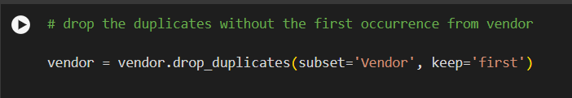
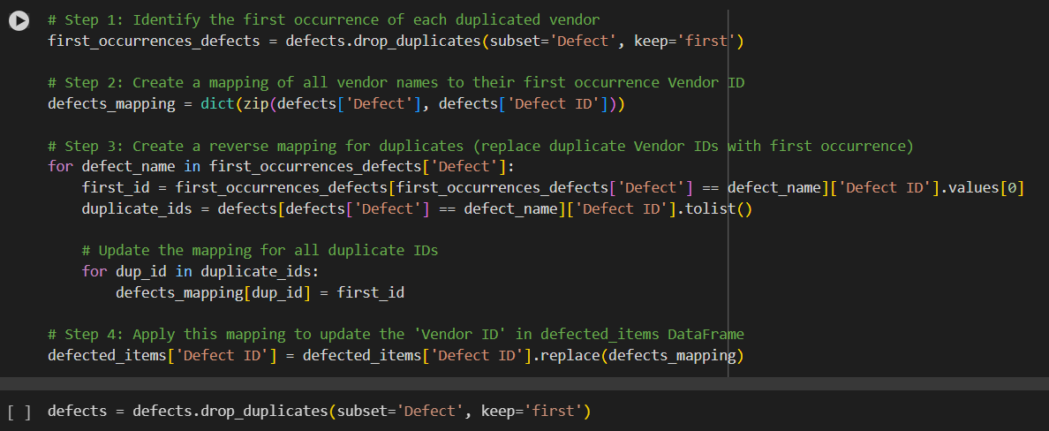
Data Cleaning
Removals
Found and removed duplicates in the Vendor dimension.
Found and removed duplicates in the Vendor dimension.

Slide 14
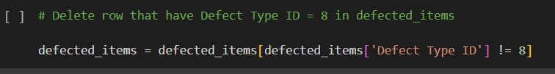
Data Cleaning
Removals
Removed the "weird" record that has all the incorrect data.

Slide 15
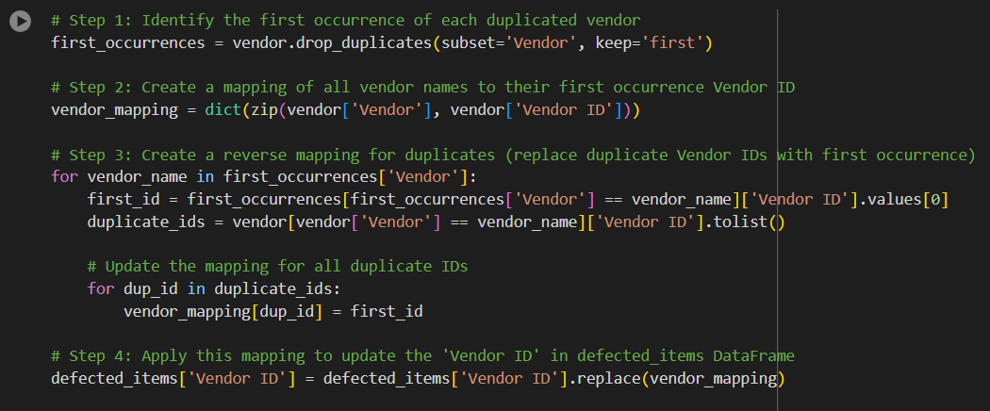
Data Cleaning
Replacements
Found and replaced all records in the Defected Items Fact that have duplicate Vendor IDs with the unique Vendor ID.

Slide 16
Data Cleaning
Replacements
Found and replaced all records in the Defected Items Fact that have duplicate Defect IDs with the unique Defect ID.

Slide 17
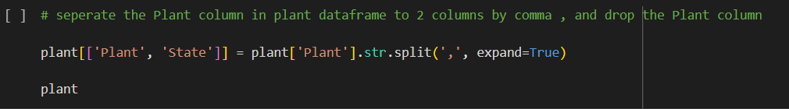
Data Cleaning
Updates
Updated the Plant table by separating the Plant column into two columns: Plant and State.

Slide 18
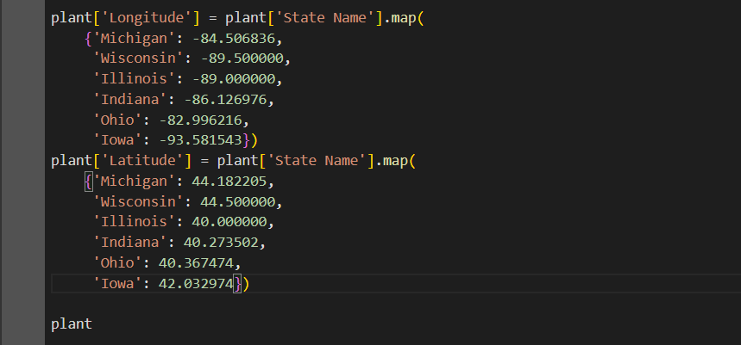
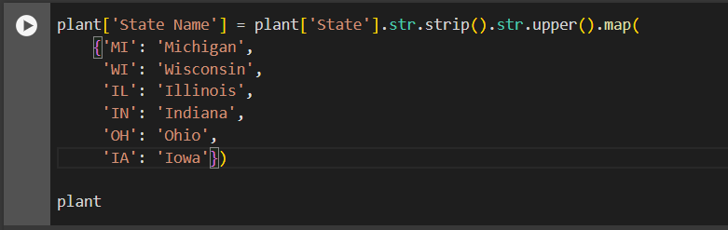
Data Cleaning
Updates
Added three more columns to the Plant table: State Name (derived from the State column), Longitude, Latitude.
Changed the Date column type in the Fact table from timestamp to just date.

Slide 19
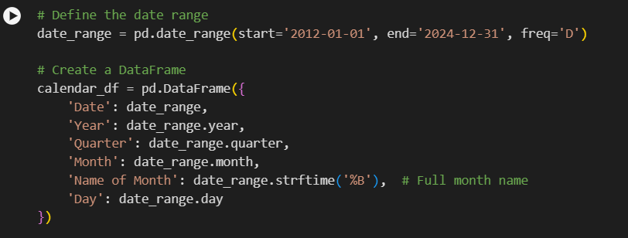
Data Cleaning
Additions
Created a Calendar dimension to help in visualizing data containing six columns: Date, Year, Quarter, Month, Name of Month, Day.

Slide 20
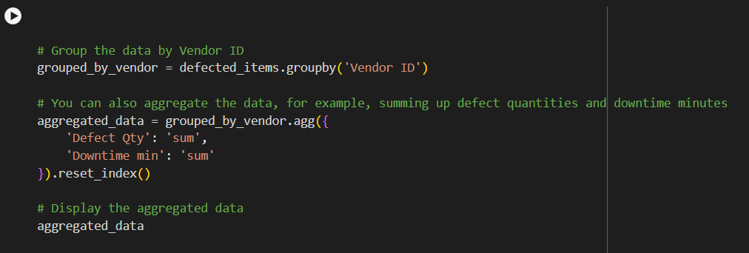
Data Cleaning
Additions
Created a Group By table to help in the benchmark story between vendors

Slide 21

Our Insights

Slide 22
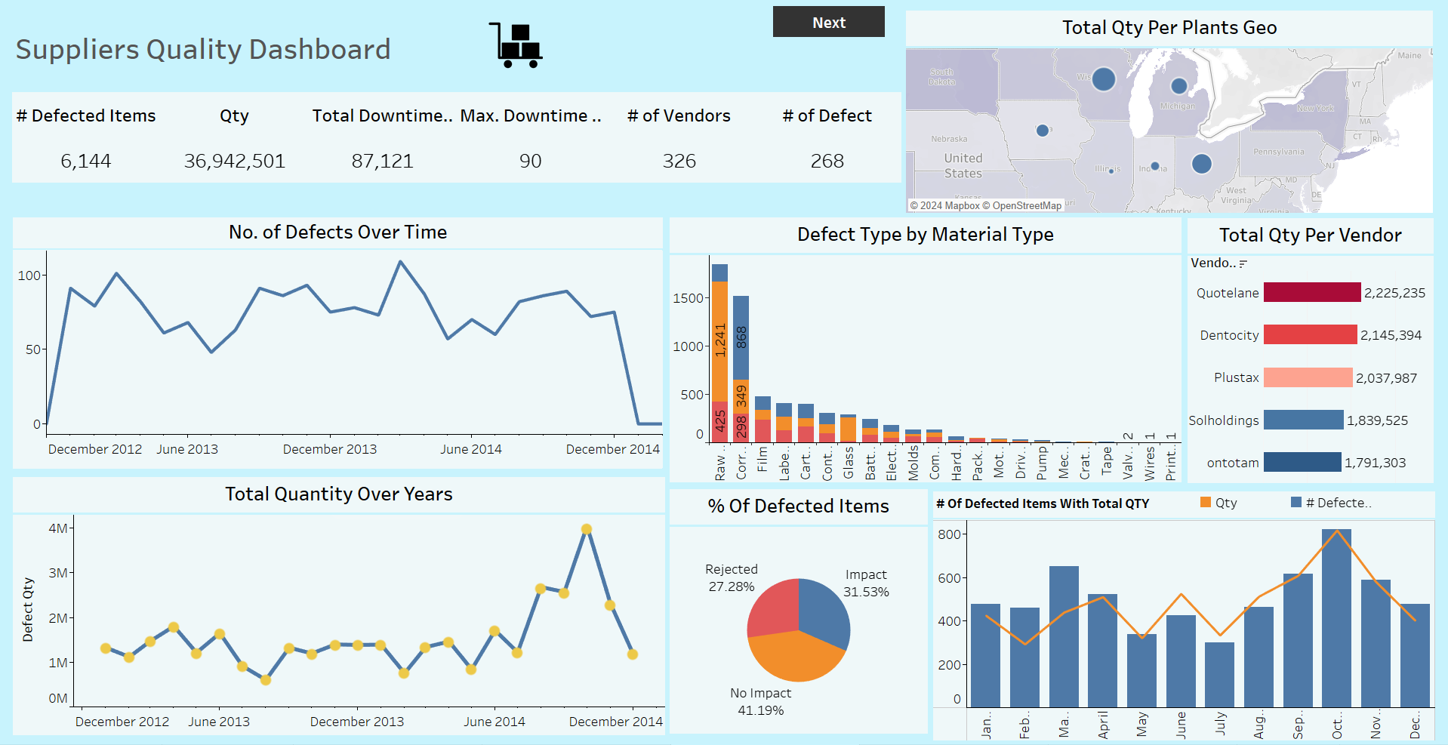
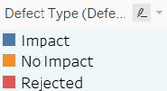

Slide 23
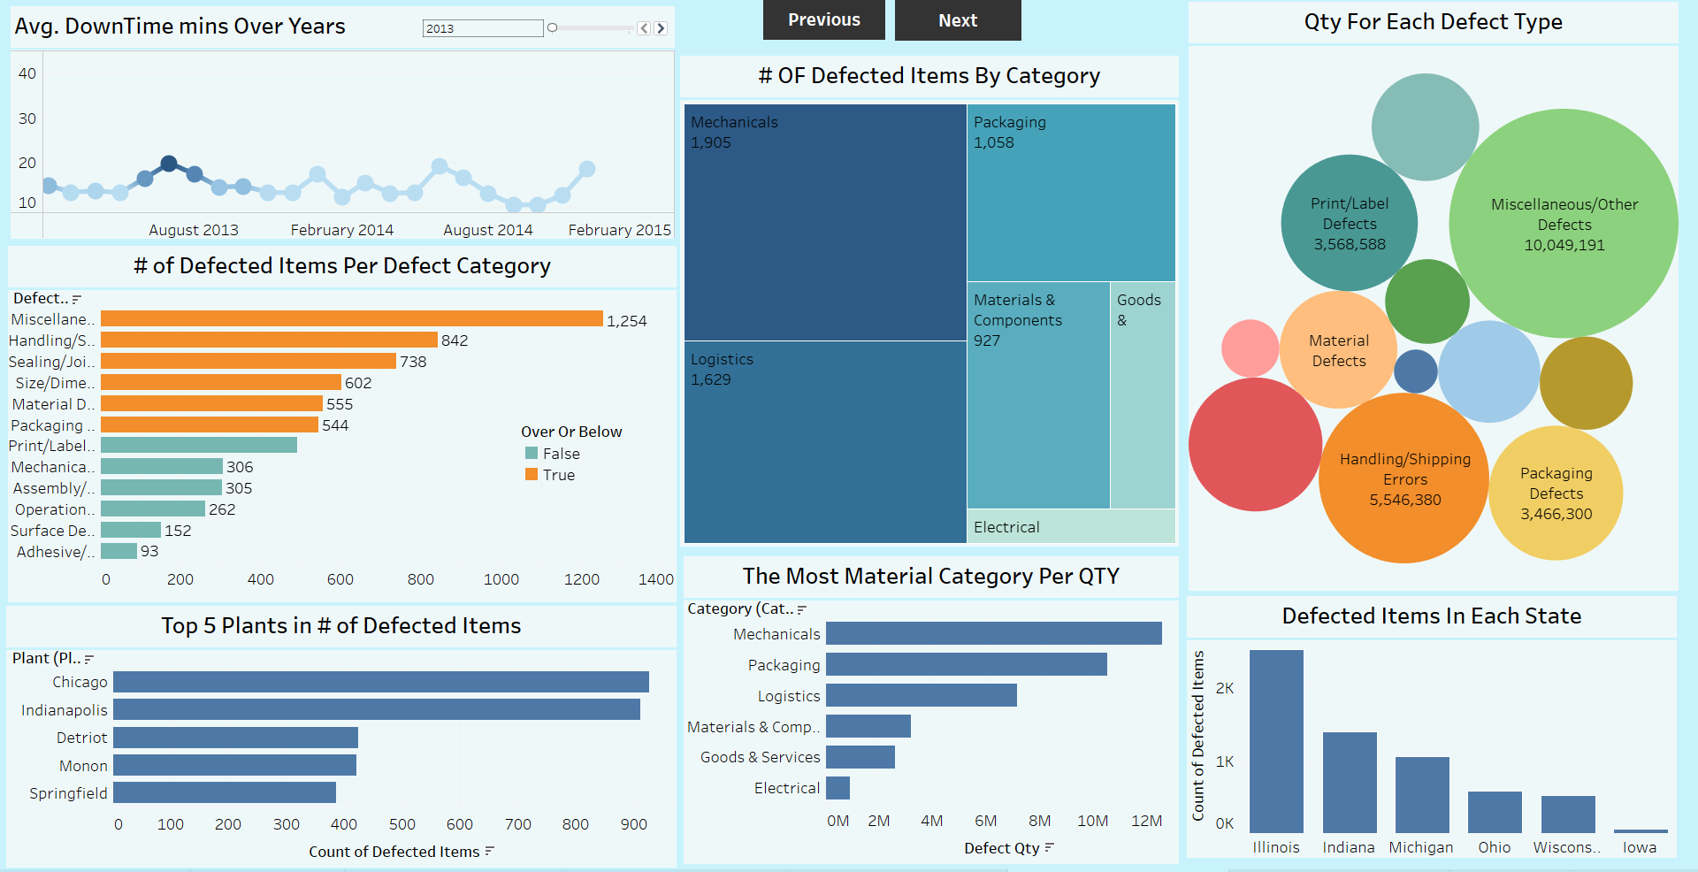

Slide 24
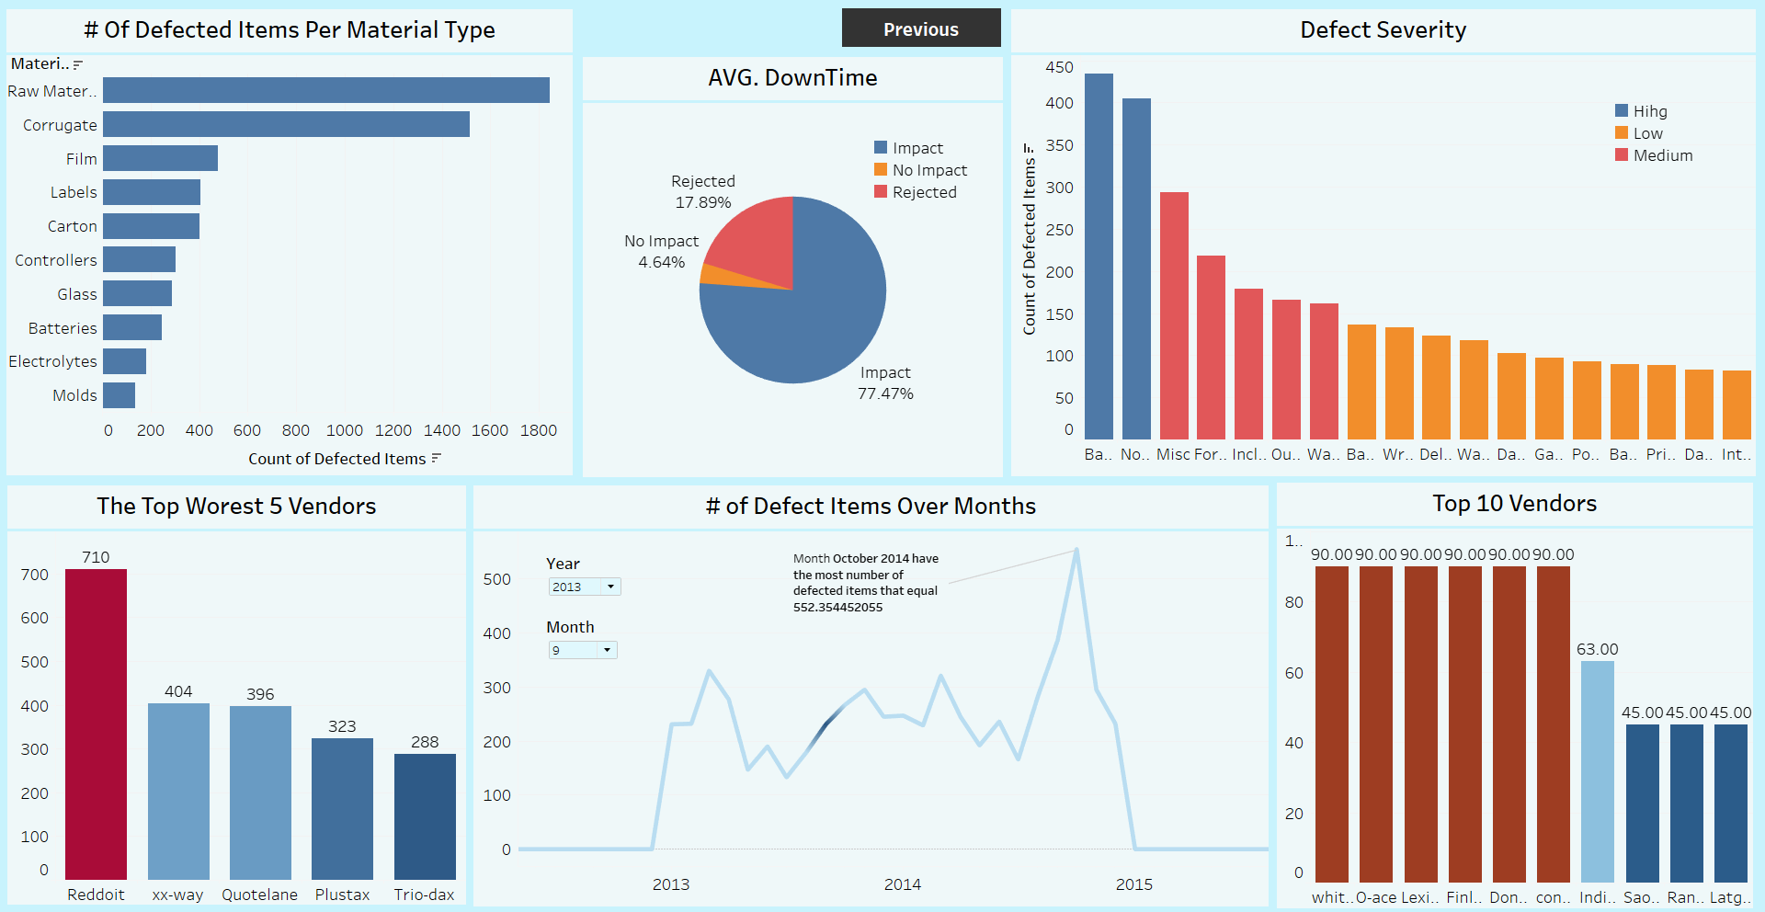

Slide 25

Total Defected QTY
36 M
Total DownTime (hr)
1453 h
Nom Of Defected Items
6144

Slide 26
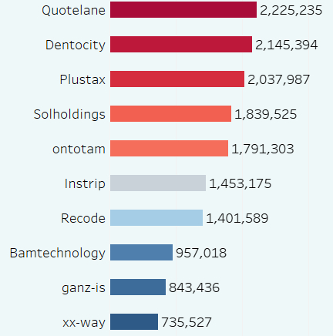
Vendors
Total Defected QTY Per Vendor
Quotelane has the highest total quantity of defective items, surpassing all other vendors in terms of overall defects.
The final vendor in the top 5 worst performers is Ontotam, rounding out the group.
Vendors
Defected QTY

Slide 27
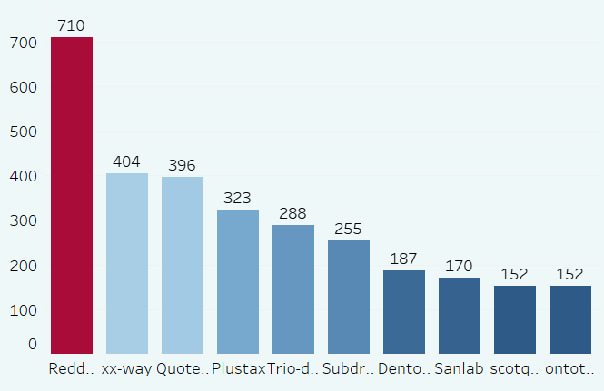
Vendors
Reddoit is the worst-performing vendor, with a notably higher number of defects—710 defective items—making it stand out significantly from other vendors.
The vendors Plustax and Trio-dax, with 323 and 288 defective items respectively, are also among the top 5 worst performers, though their defect counts are considerably lower than Reddoit.
The Worest 10 Vendors
Nom of defected Items
Vendors

Slide 28
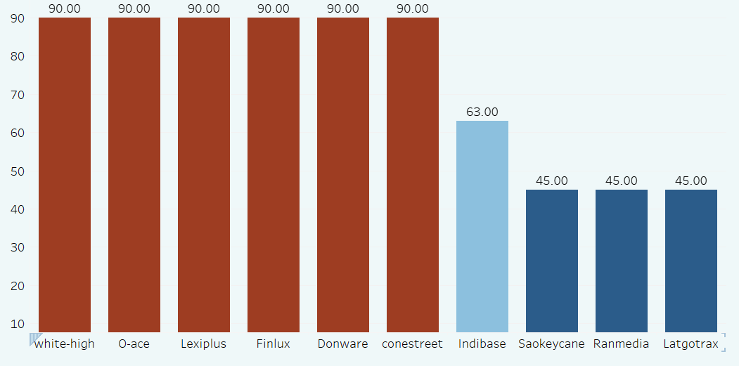
Vendors
The first six vendors—White-High, O-Ace, Lexiplus, Finlux, Donware, and Conestreet—exhibit an exceptionally high average downtime of approximately 90 minutes, significantly exceeding that of other vendors.
In contrast, the last three vendors, Saokeycane, Ranmedia, and Latgotrax, have average downtimes of 45 minutes, which is notably lower than the top five vendors.
Top 10 Vendors by AVG DT
Downtime (MIN)
Vendors

Slide 29
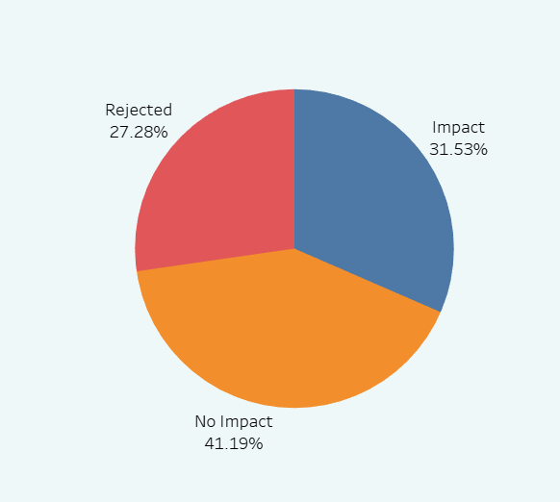
Defect Type
The No Impact type accounts for the highest percentage of defective items, making it the most common category.
The Impact and Rejected types have similar proportions; however, Rejected represents the smallest percentage among them.
% Of Defected Items

Slide 30
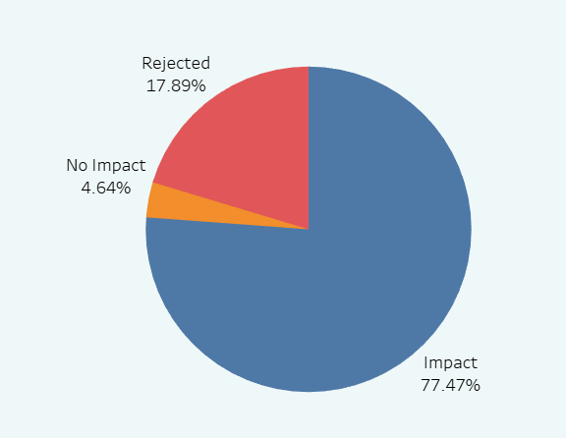
Defect Type
The Impact category has the highest percentage of average downtime in minutes, indicating it contributes significantly to overall downtime.
AVG DownTime

Slide 31
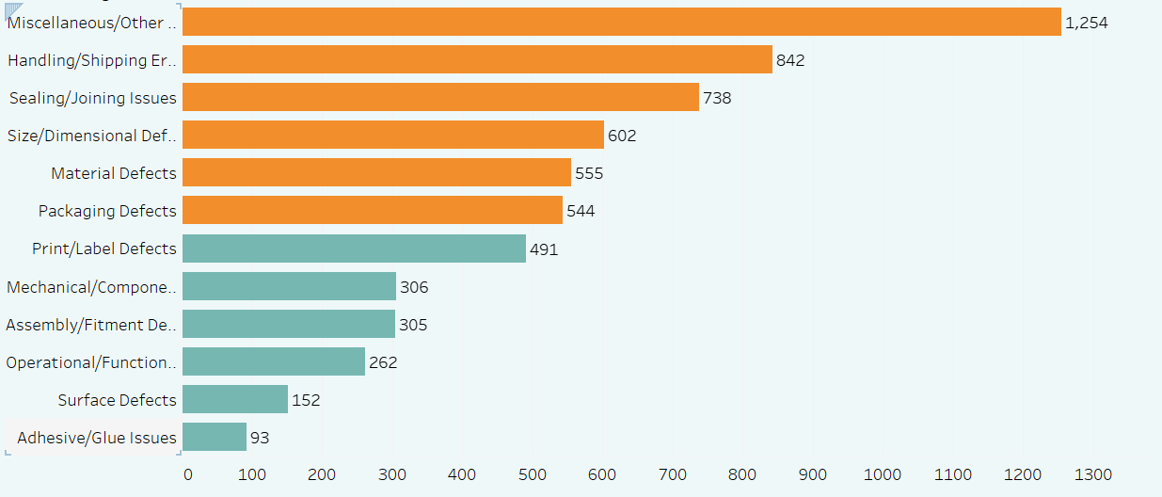
Defects
The data illustrates the number of defective items for each defect category, indicating whether the count is above or below the average.
It shows that the Miscellaneous/Other Defects category is the most affected, with the largest number of defective items.
Nom Of defected items by categry
Defected category
Nom of defected items

Slide 32
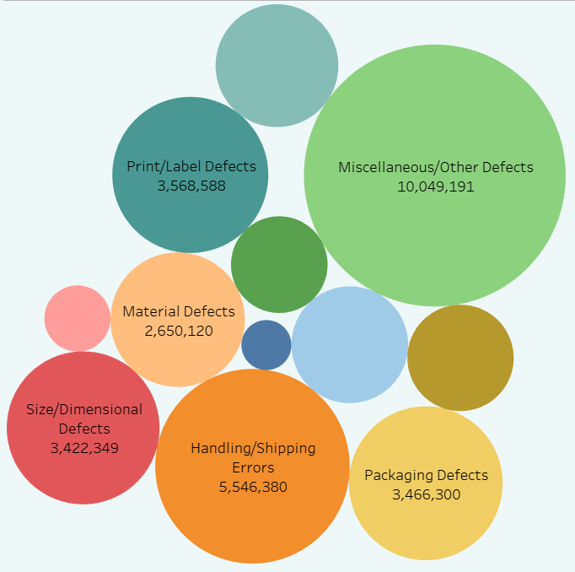
Defects
Qty Of each defect
The Miscellaneous/Other Defects category has the highest number of defective items, totaling 10 million.
Conversely, the Adhesive/Glue Issues category has the lowest count, with only 366,000 defective items.

Slide 33
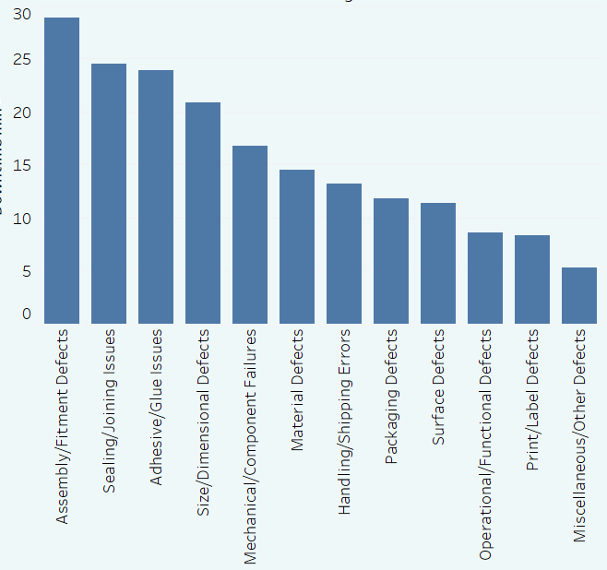
Defects
AVG DownTime Per defected Categories
While all defect categories exhibit similar proportions, Assembly/Fitment Defects still have the highest average downtime in minutes, indicating a greater impact on operations.
DownTime (MIN)
Defected Categories

Slide 34
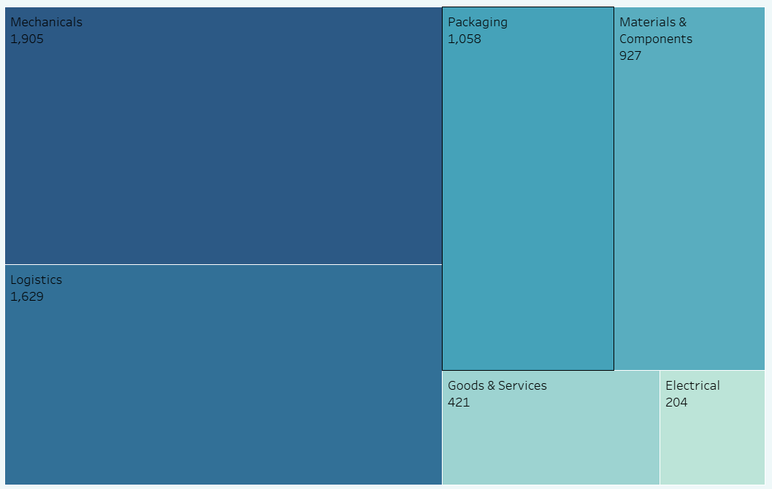
Category
The Mechanical category has the highest number of defective items, making it the most prevalent category.
In contrast, the Electrical category has the fewest defective items, indicating it is the least problematic area.
Nom Of defected items by categry

Slide 35
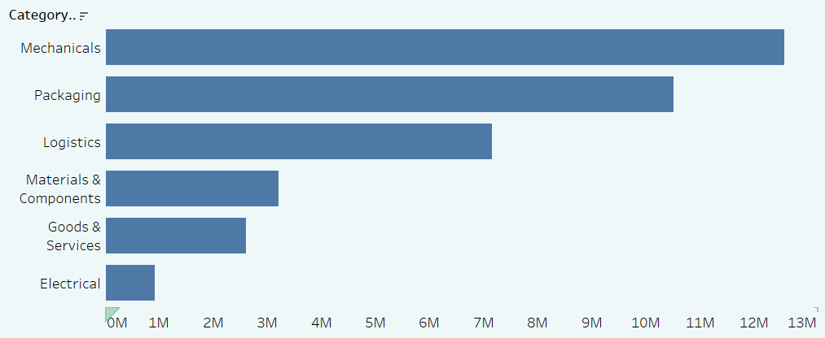
Category
The data confirms that the Mechanical category not only has the highest quantity of defective items but also supports the conclusion that the Electrical category has the lowest quantity.
The Most Material Category Per QTY
Defected Categories
Defected QTY

Slide 36
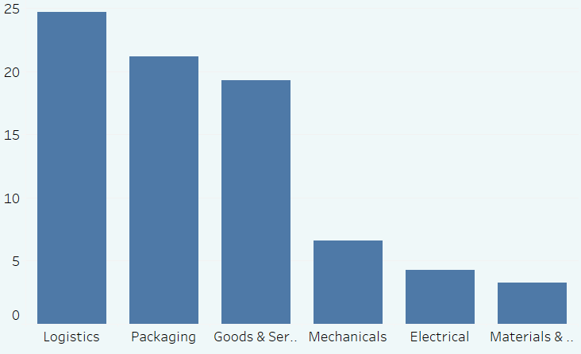
Category
However, the chart indicates that the Logistics category experiences the highest average downtime in minutes among all material categories.
AVG DownTime PEr Material Category
AVG DownTime (MIN)
Category

Slide 37
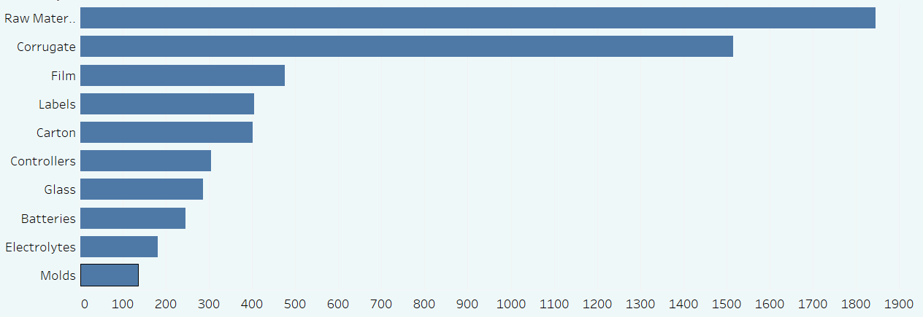
Material Type
Raw Materials and Corrugate have the highest number of defective items, indicating significant issues in these categories.
In contrast, Electrolytes and Molds have the fewest defective items, suggesting they are less problematic.
Nom Of Defected Items by material Type
Material Type
Nom Of defected Items

Slide 38
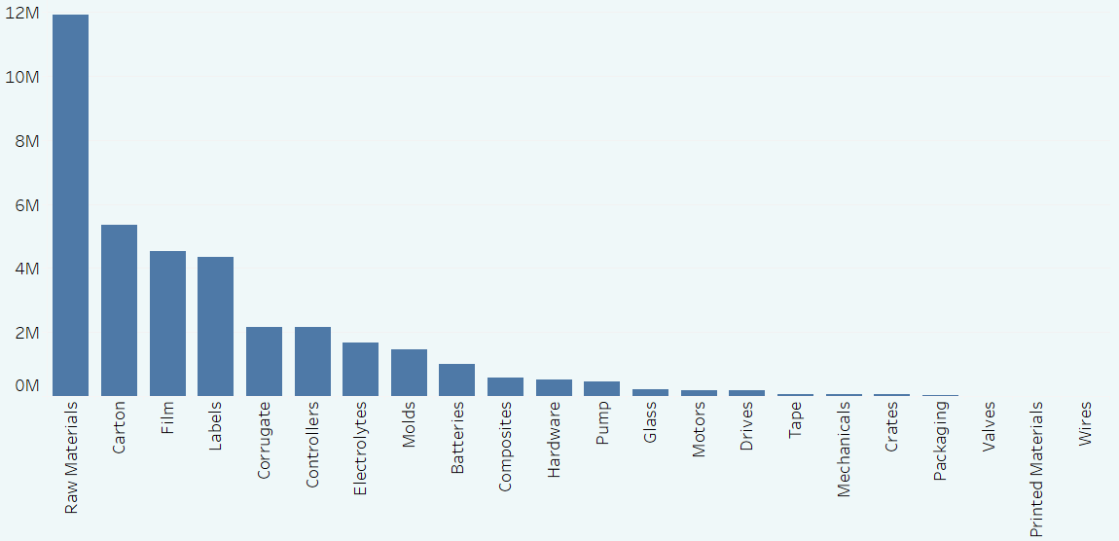
Material Type
The chart confirms that Raw Materials have the highest quantity of defective items as well.
Conversely, Wires have an exceptionally low quantity of defective items, nearly reaching zero.
QTY Of Each Material Type
Defected QTY
Material Type

Slide 39
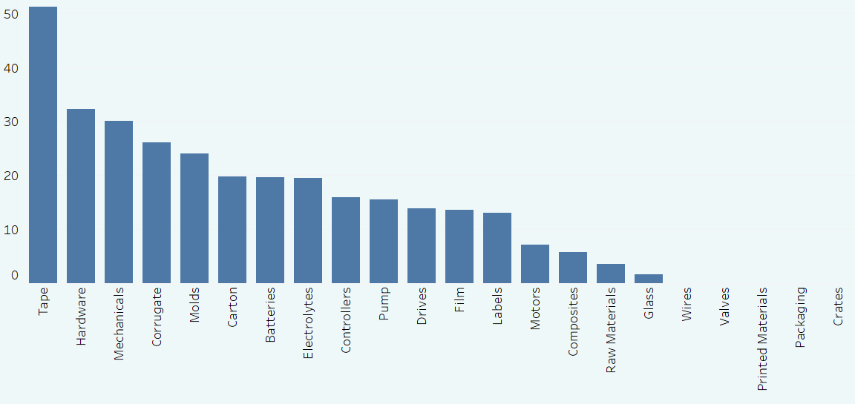
Material Type
The Tape Type category has the highest average downtime in minutes for items, indicating significant delays associated with it.
In contrast, the Crates Type category has the lowest average downtime in minutes for items, suggesting minimal impact on operations.
AVG DownTime Per Material Type
AVG DownTime
Material Type

Slide 40
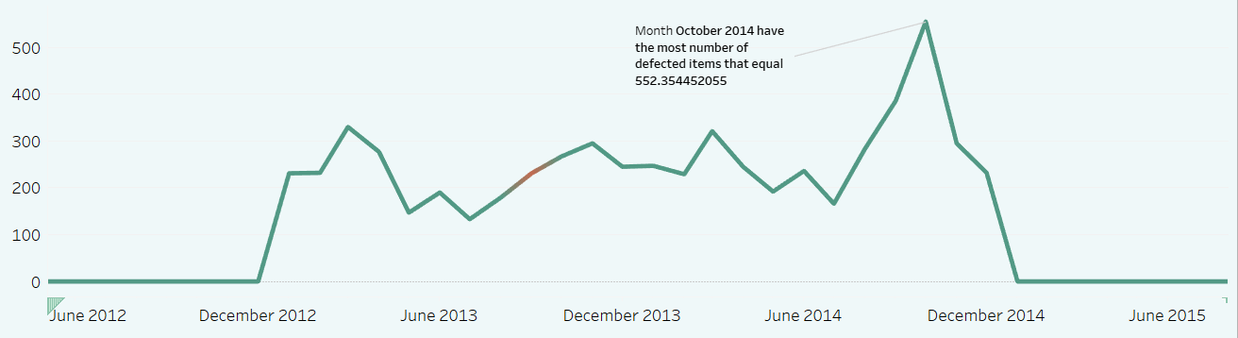
Trends
October 2014 marks the peak period, with the highest number of defective items, totaling approximately 555 items.
Following this peak, there is a significant decline in the number of defective items until the end of December.
Defected Items Over Months
Nom Defected Items
Months

Slide 41
Trends
The data reveals fluctuations between 2013 and 2014, where the number of defective items experiences several rises and falls but generally trends upward leading up to the peak.
Defected Items Over Months
Nom Defected Items
Months

Slide 42
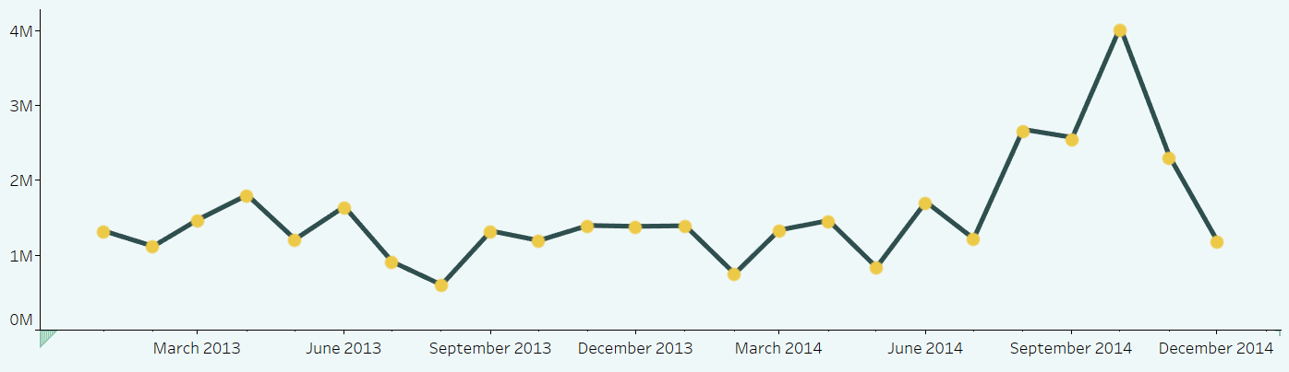
Trends
There is a noticeable upward trend in defective quantities, especially as the chart progresses toward the latter months of 2014.
The highest defect quantity is recorded in October 2014, reaching 4,046,971 defective items.
Total QTY Over Years
Defected QTY
Months

Slide 43
Trends
Throughout 2013 and 2014, the data shows significant fluctuations in the defective quantity, characterized by sharp rises and drops. The chart illustrates a cyclical pattern, but the overall volume of defects appears to increase as 2014 comes to a close.
The lowest point occurs at the end of 2013, specifically in August, with a value of 604,357 defective items.
Total QTY Over Years
Defected QTY
Months

Slide 44
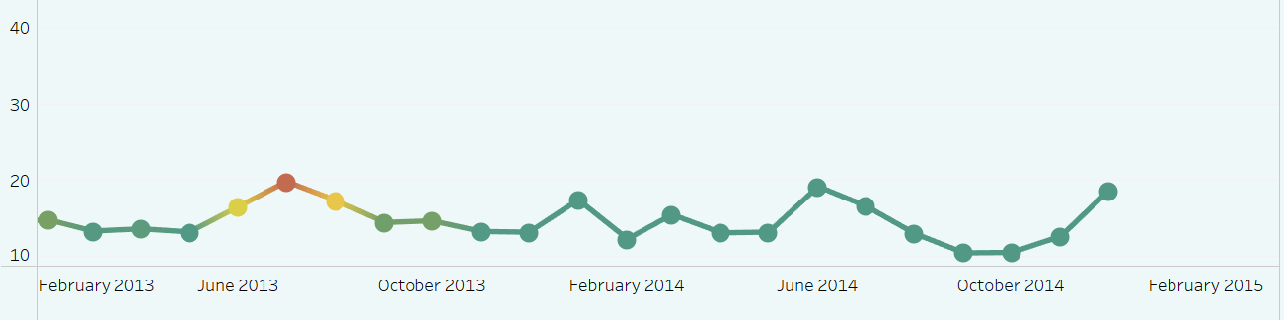
Trends
The chart reveals a cyclical pattern of peaks and valleys in downtime, with no consistent upward or downward trend over the years. This indicates fluctuating issues with machine or process efficiency rather than a continuous improvement or decline.
The peak downtime is recorded in July 2013, with an average of 19.83 minutes, marking the highest downtime in the observed timeframe.
AVG DownTime Over Years
AVG DownTime
Years

Slide 45
Trends
Several months show a significant drop in average downtime, falling below 15 minutes, particularly in May 2013, December 2013, February 2014, and September 2014.
AVG DownTime Over Years
AVG DownTime
Years

Slide 46
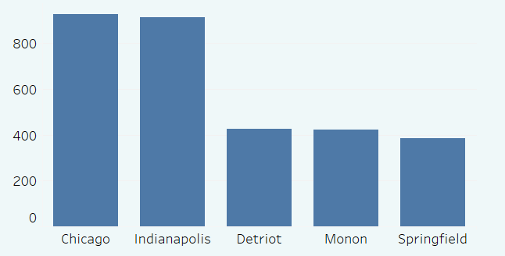
Plants
The Chicago and Indiana plants have the highest number of defective items, with similar counts of approximately 900 each.
In contrast, the Monon and Spring plants show significantly lower numbers of defects, each recording around 400 defective items.
Top 5 Plants in # of Defected Items
Defected Items
Plant

Slide 47
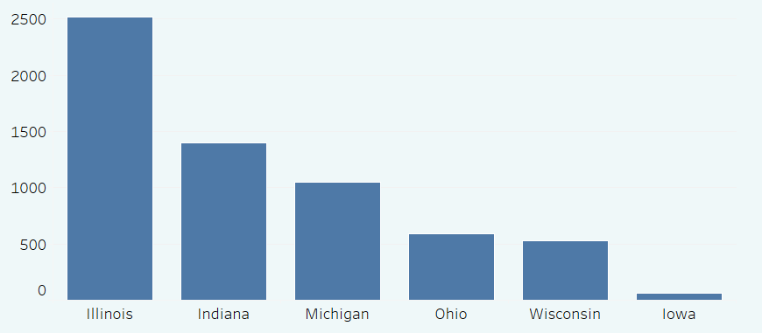
Plants
Illinois State has the highest quantity of defective items, with similar counts of approximately 2,500.
Conversely, Iowa State exhibits significantly lower numbers of defects, with around 50 defective items.
Defected Items In Each State
Defected Items
State name

Slide 48
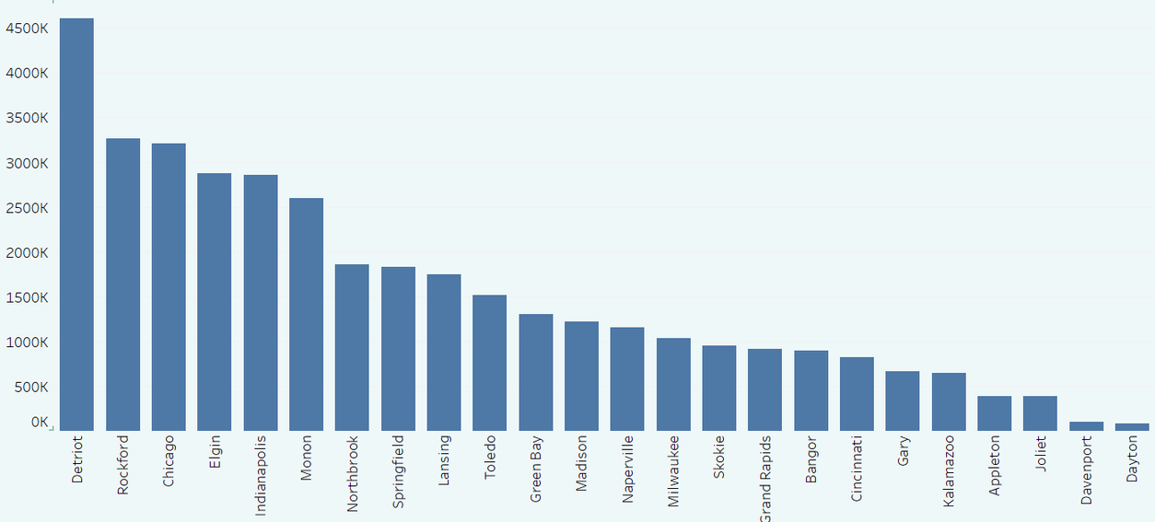
Plants
Detroit stands out with a significantly higher quantity of defects, nearing 4.5 million defective items, compared to all other plants.
There is a gradual decrease in defect quantities among the remaining plants, with Dayton and Davenport showing the lowest numbers of defects.
Total QTY in each Plant
Defected QTY
State

Slide 49
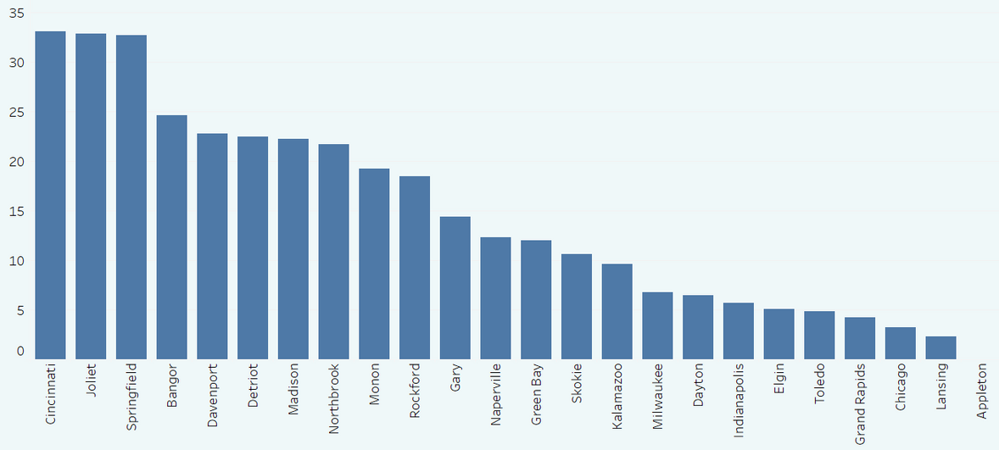
Plants
Cincinnati has the highest average downtime, exceeding 33 minutes, indicating significant operational issues or inefficiencies at this plant.
In contrast, downtime decreases steadily across the remaining plants, with the Appleton plant reporting the least downtime, at nearly 0 minutes.
AVG DownTime In Each Plant
AVG DownTime
Plant

Slide 50
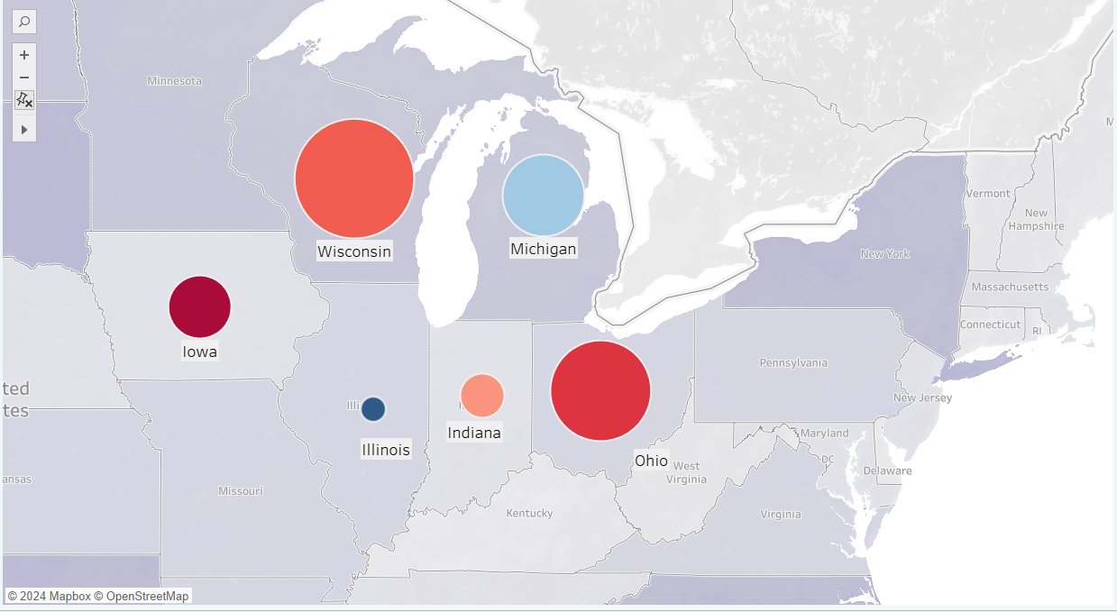
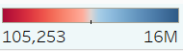
Plants
Wisconsin stands out with the highest quantity of defects, surpassing all other states by a significant margin.
Total QTY Per Plants Geo

Slide 51
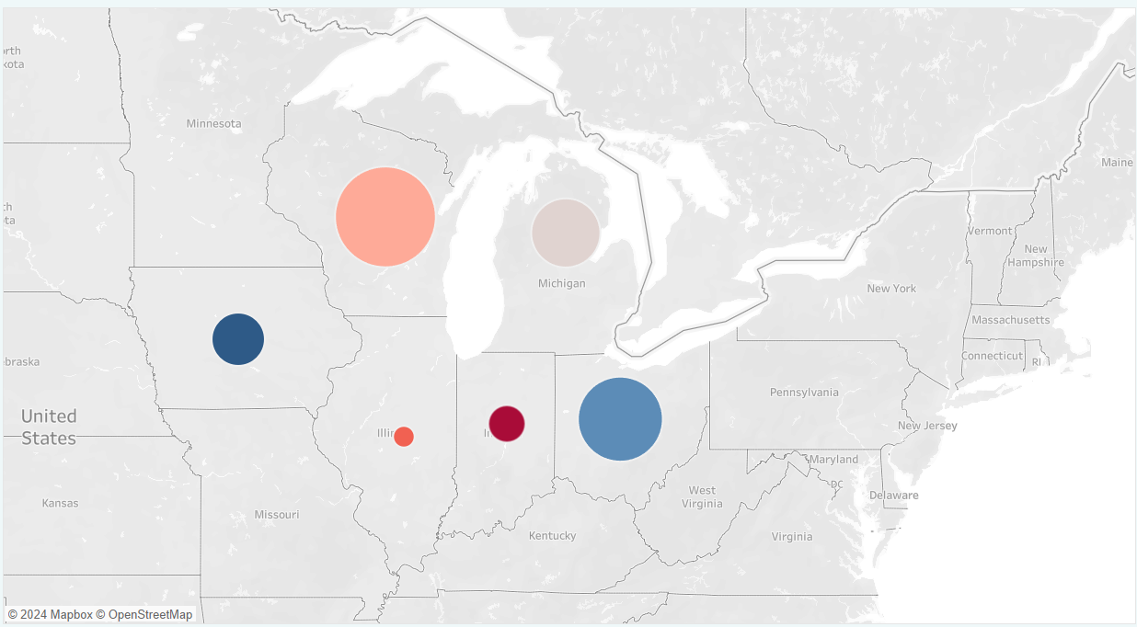
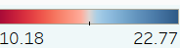
Plants
Iowa has the highest average downtime, exceeding 22 minutes, which indicates significant operational issues or inefficiencies in this state.
Conversely, the downtime decreases steadily across the remaining states, with the Indiana plant recording the least downtime, at nearly 10 minutes.
AVG DownTime In Each State

Slide 52

Key Findings

Slide 53









Product 03
Vendors
Defects
Material Types
Defects Types
Plants
States
Material Categories
Over Time

Slide 54

Recommendations

Slide 55

What strategies can reduce defect rates and improve product quality?
Focus on reducing defects in raw materials that currently show no impact.
1
Target rejected defects in raw and corrugated materials to enhance quality and reduce costs.
2
Review sourcing and production processes to address defects in materials like film and labels.
3
Focus on improving quality control in plants like Chicago, Indiana, and Detroit with high defect rates.
4

Slide 56
Illinois needs more attention due to having the highest number of defective items across its plants.
What strategies can reduce defect rates and improve product quality?
5
Address high downtime at the Cincinnati plant to improve productivity.
6
Work closely with major vendors like Reddoit and Quotelane to reduce overall defect rates.
7
Investigate the spike in defects from October 2014 to identify potential production or quality control issues.
8

Slide 57

Next Steps:
Advancing Insights in Future

Slide 58
Key Enhancements for Future Analysis
1
Add Material Dimension
5
Capture Environmental Factors
Enrich Defected Items Fact Table: adding (Material Costs, Cost of Defects, Downtime Cost per Minute)
6
Integrate Logistics and Supply Chain Data
2
3
Enhance Vendor Dimension: Add Vendor Rating feature
7
Add Customer Feedback and Satisfaction Metrics
4
Introduce Machine and Maintenance Data
8
Incorporate Process Variables

Slide 59


Slide 60


